Slide 1

Finding the best place to open an Italian restaurant in Moscow
30 June 2020

Slide 2
PARAMETERS
Goal:
to find location for the new Italian restaurant in Moscow with the following parameters
Conditions (both have to be met):
no Italian restaurants in vicinity
as close to city center as possible

Slide 3
DATA
DATA SOURSES:
Google Maps API: reverse geocoding
Foursquare API: number of restaurants and their type and location in every neighborhood will be obtained using

Slide 4
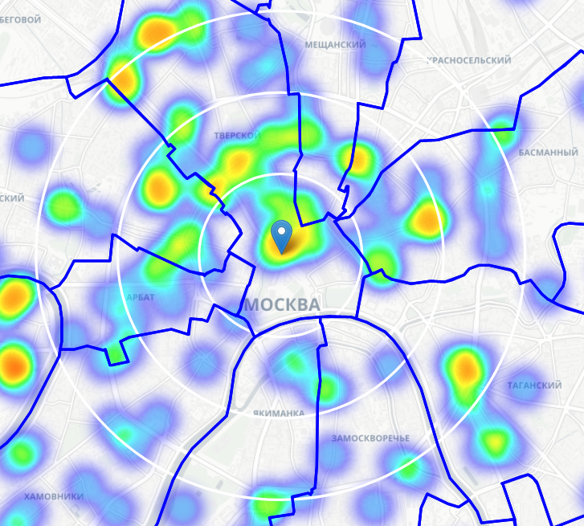
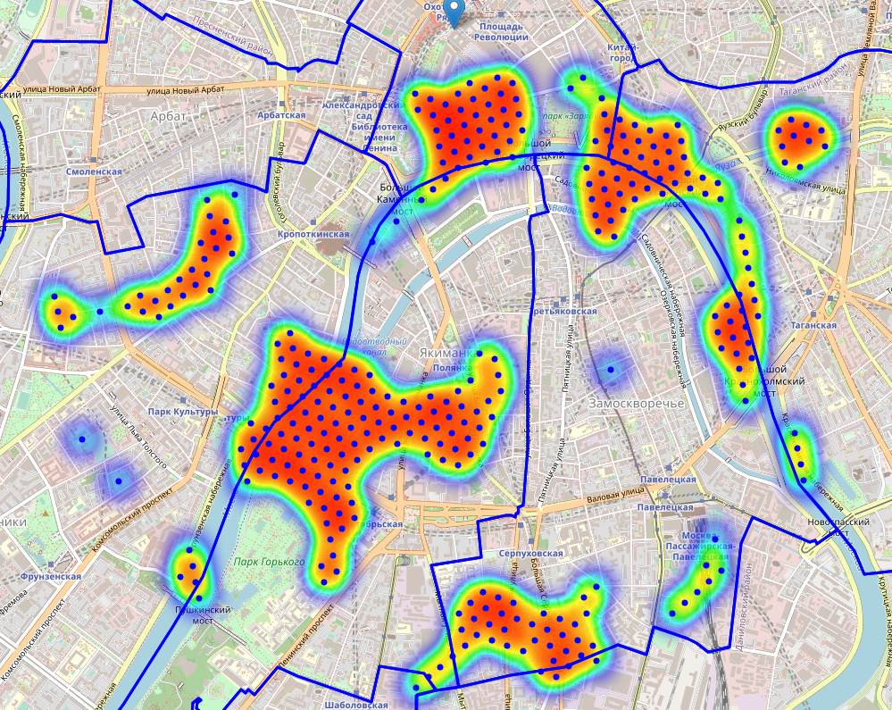
ANALYSIS
R = 1km
R = 2km
R = 3km
Density of restaurants in Moscow center
Locations with no more than two restaurants in radius of 250 meters, and no Italian restaurants in radius of 400 meters

Slide 5
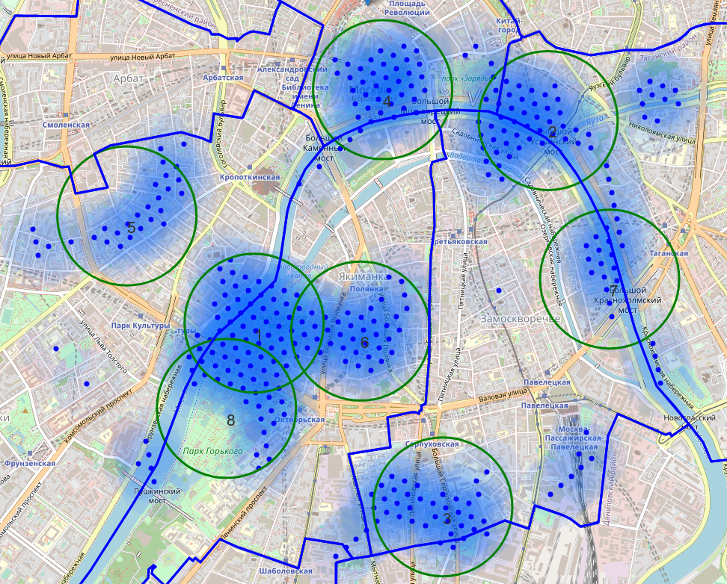
ANALYSIS
List of found clusters:
area 1: Krymskaya nab., 16 building 1, Moscow, 119049 => 2.5km from Kremlin
(Surroundings of the Museum and Exhibition Center State Tretyakov Gallery on Krymsky Val)
area 2: Moskvoretskaya Embankment, 7, стр.1, Moscow, 109240 => 1.6km from Kremlin
(Landmark Imperial educational house and part of Moskvoretskaya embankment with a pier)
area 3: Bolshaya Serpukhovskaya, house 40, building 2, Moscow,115093 => 3.7km from Kremlin
(Mostly residential area next to the children's hospital)
area 4: Kremlin
area 5: Malyy Levshinskiy Pereulok, 14/9 строение 1, Moscow, 119034 => 2.4km from Kremlin
(Prechistenka Street (right side) mostly business area)
area 6: Ulitsa Malaya Polyanka, 8, Moscow, 119180 => 2.4km from Kremlin
(1st Khvostov lane mostly buiseness area near French embassy)
area 7: Kosmodamianskaya Naberezhnaya, 38 строение 2, Moscow, 115035 => 2.7km from
(Kosmodamianskaya embankment - residential area and business area)
area 8: Unnamed Road, Moscow, 119049 => 3.1km from Kremlin
(Gorky Park)
Cluster area 4 was excluded from above list, since the Kremlin is a closed area and it is impossible to open a restaurant there.
Clusters of good locations

Slide 6
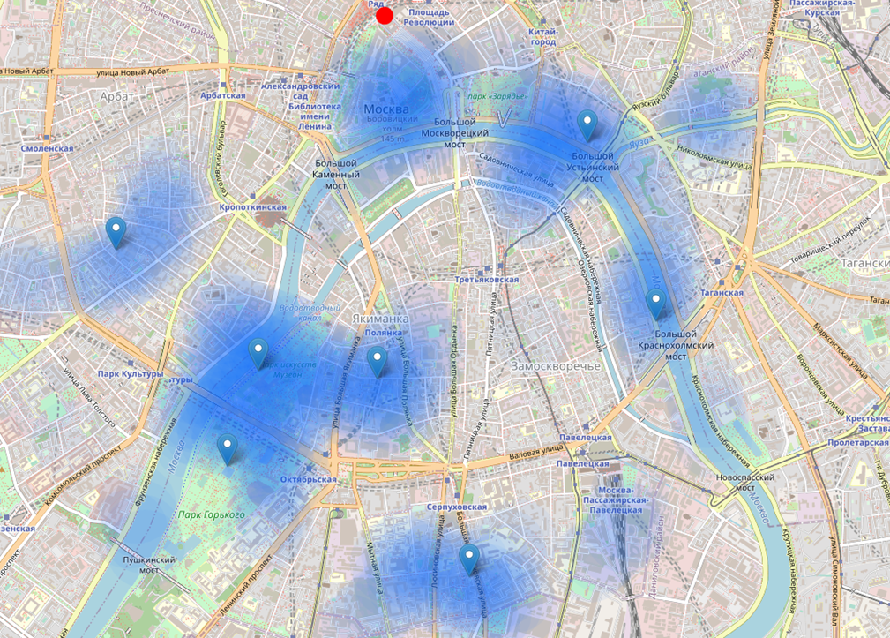
Result
Result of all this is 7 zones containing largest number of potential new restaurant locations based on number of and distance to existing venues - both restaurants in general and Italian restaurants particularly. This, of course, does not imply that those zones are actually optimal locations for a new restaurant! Purpose of this analysis was to only provide info on areas close to Moscow center but not crowded with existing restaurants (particularly Italian) - it is entirely possible that there is a very good reason for small number of restaurants in any of those areas, reasons which would make them unsuitable for a new restaurant regardless of lack of competition in the area. Recommended zones should therefore be considered only as a starting point for more detailed analysis which could eventually result in location which has not only no nearby competition but also other factors taken into account and all other relevant conditions met.
Centers of the zones can be good starting point for further research of places to open a new restaurant

